Slide 1

Replication and Improvement of ‘The Impact of Campaign Finance Laws on Party Competition’ (2013)
By Ruairí Hallissey

Slide 2
Background
By Joshua Potter and Margit Tavits (2013)
Paper looks at whether campaign finance laws effect the number of political parties (ENP)
Theory: Campaign Expenses are a constraint on party political actors
Hypothesis: Countries with laws that promote fund parity will have a greater number of effective political parties

Slide 3
Methodology
OLS Regression
Data for 130 countries
Post Election Effective Number of Parities (y)
No. parties weighted by relative strength
Fund Parity (x1)
Donation Limits
Spending Limits
Free Media Access
Direct public funding
Controls
Years as Democracy, Federal vs. Non-Federal, Parliamentary vs. Presidential, District Magnitude, Ethnic Fractionalization

Slide 4
Dependent variable: ENP
-------------------------------------------
Full Post 1974
---------------------------------------------------------------
fundparity4 0.438*** 0.454**
(0.153) (0.210)
demyears 0.013 -0.013
(0.011) (0.033)
Federal -0.213 -0.228
(0.476) (0.754)
Presidential -0.172 -0.025
(0.211) (0.284)
log(avemag) 0.601** 0.343
(0.301) (0.446)
Fract .956 -0.427
(1.290) (1.911)
log(avemag):fract -0.750 -0.576
(0.641) (0.889)
Constant 3.070*** 4.383***
(0.764) (1.217)
---------------------------------------------------------------
Observations 90 54
R2 0.198 0.168
Adjusted R2 0.129 0.041
Residual Std. Error 1.647 (df = 82) 1.792 (df = 46)
F Statistic 2.885*** (df = 7; 82) 1.327 (df = 7; 46)

Slide 5
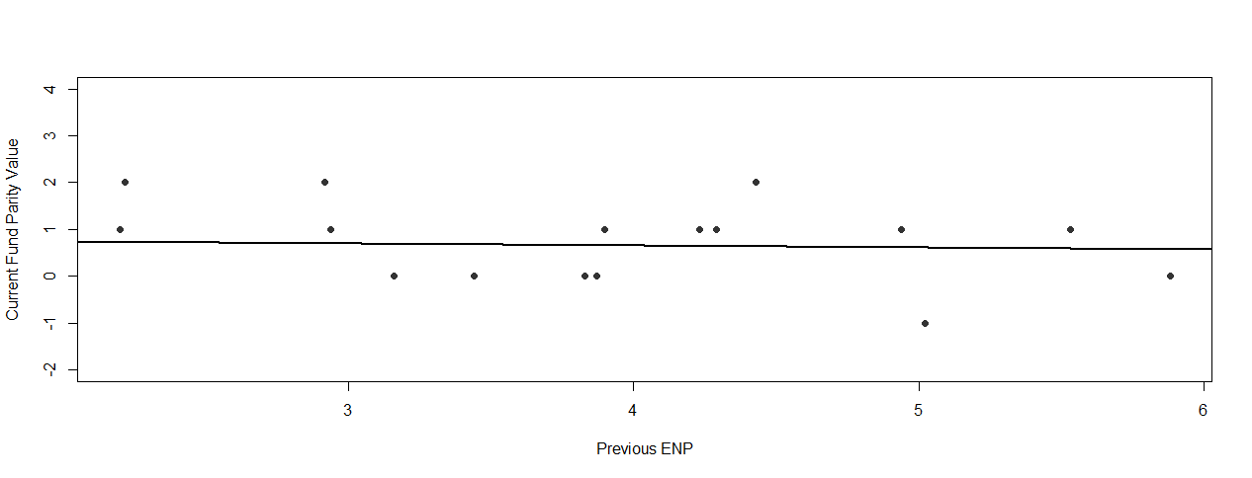
Reverse Causality?
Fig. 1. Plot of ‘current’ level of fund parity against ‘previous’ effective number of parties
Note: ordinary least squares regression line included to demonstrate that there is no relationship between the two variables (r 0.04).

Slide 6
Additions
Does being a presidential system, in interaction with time spent as a democracy, reduce the effective number of parties?
Recode pres variable

Slide 7
Dependent variable: ENP
--------------------------------------------------
Full Full w/Recode
-----------------------------------------------------------------------
fundparity4 0.438*** 0.437***
(0.153) (0.157)
demyears 0.013 0.013
(0.011) (0.011)
Federal 0.213 -0.295
(0.476) (0.480)
Presidential -0.172
(0.211)
Pres_cat -0.346
(0.422)
log(avemag) 0.601** 0.439
(0.301) (0.319)
fract 0.956 0.522
(1.290) (1.309)
log(avemag):fract -0.750 -0.190
(0.641) (0.727)
Constant 3.070*** 3.195***
(0.764) (0.770)
----------------------------------------------------------------------------
Observations 90 85
R2 0.198 0.214
Adjusted R2 0.129 0.143
Residual Std. Error 1.647 (df = 82) 1.645 (df = 77)
F Statistic 2.885*** (df = 7; 82) 2.996*** (df = 7; 77)
===============================================
Note: *p<0.1; **p<0.05; ***p<0.01

Slide 8
Dependent variable: ENP
-------------------------------------------
Full w/Recode Interactive
-----------------------------------------------------------------
fundparity4 0.437*** 0.444***
(0.157) (0.153)
demyears 0.013 0.025**
(0.011) (0.012)
Federal -0.295 -0.270
(0.480) (0.467)
pres_cat -0.346 1.095
(0.422) (0.744)
log(avemag) 0.439 0.434
(0.319) (0.310)
fract 0.522 0.223
(1.309) (1.280)
demyears:pres_cat -0.055**
(0.024)
log(avemag):fract -0.190 -0.167
(0.727) (0.707)
Constant 3.195*** 2.790***
(0.770) (0.769)
------------------------------------------------------------------------------
Observations 85 85
R2 0.214 0.266
Adjusted R2 0.143 0.189
Residual Std. Error 1.645 (df = 77) 1.600 (df = 76)
F Statistic 2.996*** (df = 7; 77) 3.446*** (df = 8; 76)
==============================================
Note: *p<0.1; **p<0.05; ***p<0.01

Slide 9
Analysis of Variance
=================================
Statistic N Mean St. Dev. Min Max
---------------------------------------------------------
Res.Df 2 76.50 0.707 76 77
RSS 2 201.48 9.780 194.566 208.397
Df 1 1.000 1 1
Sum of
Sq 1 13.831 13.831 13.831
F 1 5.403 5.403 5.403
Pr(> F) 1 0.023 0.023 0.023
------------------------------------------------------------

Slide 10
Dependent variable: ENP
-------------------------------------
Post 74 Additive Post 74 Interactive
-----------------------------------------------------------
fundparity4 0.472** 0.479**
(0.224) (0.223)
demyears -0.016 0.015
(0.035) (0.044)
fed -0.340 -0.515
(0.775) (0.789)
pres_cat -0.027 1.289
(0.578) (1.323)
log(avemag) 0.139 0.149
(0.487) (0.486)
fract -1.108 -1.364
(1.994) (2.002)
demyears:pres_cat -0.074
(0.067)
log(avemag):fract 0.102 0.100
(1.061) (1.058)
Constant 4.612*** 4.111***
(1.248) (1.325)
-----------------------------------------------------------
Observations 49 49
R2 0.177 0.202
Adjusted R2 0.037 0.042
Residual Std. Error 1.819 (df = 41) 1.814 (df = 40)
F Statistic 1.261 (df = 7; 41) 1.262 (df = 8; 40)
============================================
Note: *p<0.1; **p<0.05; ***p<0.0

Slide 11
Analysis of Variance
===================================
Statistic N Mean St. Dev. Min Max
------------------------------------------------------------
Res.Df 2 40.50 0.707 40 41
RSS 2 13.68 2.844 131.673 135.696
Df 1 1.000 1 1
Sum of
Sq 1 4.023 4.023 4.023
F 1 1.222 1.222 1.222
Pr(> F) 1 0.276 0.276 0.276
-------------------------------------------------------------

Slide 12
Fin

Slide 13
Takeaway
Fund parity is a major predictor of the effective number of parties
Parliamentary and Presidential system do affect the number of parties, however the effects work differently over time

